Slide 1
Subjects offered in TAS
Design and Technology Engineering Studies Exploring Early Childhood Food Technology Hospitality (VET): Hospitality – Food and Beverage - VET Hospitality – Kitchen Operations and Cookery Stream - VET Hospitality Specialisation (available in Year 12) - VET | Industrial Technology: Automotive Metal Timber and Furniture Making Information Communication Technology: Software Design and Development Information Processes and Technology Information and Digital Technology Curriculum Framework Society and Culture Textile and Design

Slide 2
Design and Technology
Board Developed Course
2 units – Preliminary and HSC
Category A
ATAR
Course Description
The Preliminary course involves the study of both designing and producing. This is explored through areas such as design theory and practice, design processes, environmental and social issues, communication, research, technologies, and the manipulation of materials, tools and techniques. The course involves hands-on practical activities which develop knowledge and skills in designing and producing. The Preliminary course includes the completion of at least two design projects. These projects involve the design, production and evaluation of a product, system or environment and includes evidence of the design process recorded in a design folio. The design folio can take a variety of different forms.
The HSC course applies the knowledge and understanding of designing and producing from the Preliminary course. It involves the development and realisation of a Major Design Project, a case study of an innovation, along with the study of innovation and emerging technologies. The study of the course content is integrated with the development of a Major Design Project, worth 60% of the HSC mark. This project requires students to select and apply appropriate design, production and evaluation skills to a product, system or environment that satisfies an identified need or opportunity. The case study of an innovation requires students to identify the factors underlying the success of the innovation selected, analyse associated ethical issues and discuss its impact on Australian society.

Slide 3
What you will learn:
Preliminary course | HSC course
Involves both theory and practical work in designing and producing. This includes the study of design theory and practice, design processes, factors affecting design and producing, design and production processes, technologies in industrial and commercial settings, environmental and social issues, creativity, collaborative design, project analysis, marketing and research, management, using resources, communication, manufacturing and production, computer-based technologies, work health and safety, evaluation, and manipulation of materials, tools and techniques. | Involves the study of innovation and emerging technologies, including a case study (20%) of an innovation and the study of designing and producing including a Major Design Project. The project folio addresses three key areas: project proposal and project management, project development and realisation, and project evaluation.

Slide 4
Course requirements:
In the Preliminary course, students must participate in hands-on practical activities and undertake a minimum of two design projects. The projects will develop skills and knowledge to be further developed in the HSC course. Students will develop their knowledge of the activities within industrial and commercial settings which support design and technology and relate these processes to the processes used in their own designing and producing. Each project will place emphasis on the development of different skills and knowledge in designing and producing. This is communicated in a variety of forms, but students should be encouraged to communicate their design ideas using a range of appropriate media.
In the HSC course the activities of designing and producing that were studied in the Preliminary course are synthesised and applied. This culminates in the development and realisation of a Major Design Project and a case study of an innovation. Students should select and use the wide range of skills and knowledge developed in the Preliminary course, appropriate to their selected project. They must also relate the techniques and technologies used in industrial and commercial settings to those used in the development of design projects.

Slide 5
HSC Exam Requirements
HSC written paper exam – 1½ hour = 40%
The Major Design Project will include the submission of:
a folio documenting the project proposal and project management, project development and realisation, and project evaluation
a product or a system or an environment

Slide 6
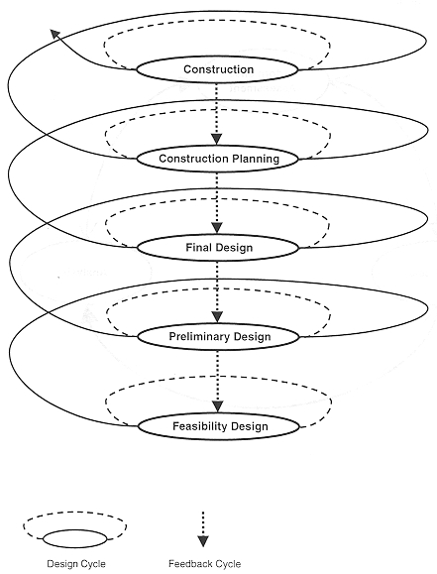
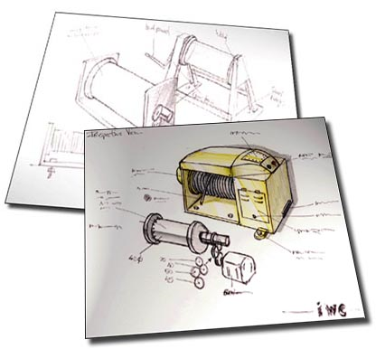
Apply the design process

Slide 7
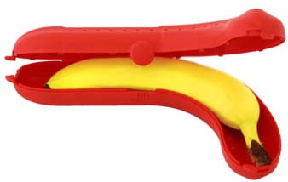
D
E
S
I
G
N
I
N
G
A look at designs out of the box.

Slide 8
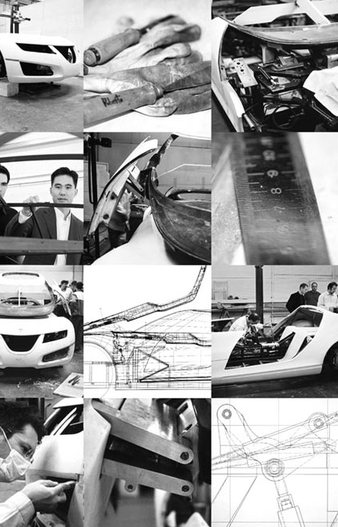
Research, communicate & manage
the design production

Slide 9
Engineering Studies
Board Developed Course
2 Units – Preliminary and HSC
Category A
ATAR
Course Description:
Both Preliminary and HSC courses offer students knowledge, understanding and skills in aspects of engineering that include communication, engineering mechanics/hydraulics, engineering materials, historical/societal influences, engineering electricity/electronics, and the scope of the profession. Students study engineering by investigating a range of applications and fields of engineering.

Slide 10
What you will learn
Preliminary course | HSC course
Students undertake the study of 4 compulsory modules: THREE application modules based on engineering concepts and impacts through the study of engineering products. Engineering concepts and impacts are studied in each of the following categories: Engineering Fundamentals Engineered Products and Braking Systems ONE focus module relating to the field of Biomedical Engineering. Students are required to produce a component of an engineering report in Engineering application module 3, Braking Systems, and then a complete engineering report in Engineering focus module 4, Biomedical Engineering | Students undertake the study of 4 compulsory modules: TWO application modules relating to the fields of: Civil Structures and Personal and Public Transport TWO focus modules relating to the fields of: Aeronautical Engineering and Telecommunications Engineering. Students are required to produce one engineering report from either of the two engineering application modules, and one from either of the two engineering focus modules. One engineering report from the Preliminary course and one engineering report from the HSC course must be the result of collaborative work, reflecting the importance of teamwork for successful engineering projects.

Slide 11
HSC Exam Requirements
Component | Weighting
Knowledge and understanding of course content | 60%
Knowledge and skills in research, problem solving and communication related to engineering practice | 40%
HSC written exam: 3 hours
+ 5 minutes reading time

Slide 12
Engineering Studies
Key responsibilities now include:
Wealth creation
Ethical considerations
Sustainability
Enivronmental friendly Technologies
Meeting society’s needs

Slide 13
Careers
Engineering Studies is unique in that it develops knowledge and understanding associated with a study of engineering. It also provides an opportunity to integrate the science and mathematics disciplines with issues of society and change. This would be a great start to any technical based course:
Architecture
Surveying
Metallurgist
Industrial Design
Textile Industry
Engineering
Environmental Science
Technician
Scope of an engineer?
Role of an engineer?
Understanding engineering principles
Understanding the responsibilities of an engineer
Communication skills
Problem solving skills

Slide 14
Exploring Early Childhood
Content Endorsed Course Category C No HSC exam
No ATAR
Our society is increasingly recognising that children's experiences in the early childhood years form the foundation for future growth, development and learning.
This course explores issues within an early childhood context and considers these in relation to the students themselves, their family and the community.

Slide 15
What you will learn:
knowledge and understanding about the physical, social-emotional, behavioural, cognitive and language development of young children
knowledge and understanding about the environmental factors that have an impact on young children’s growth and development
knowledge and understanding about the development and maintenance of positive behaviours and relationships with young children
skills in communication and interaction, research and analysis and decision-making and evaluation
respect for the individuality and uniqueness of young children and their families
an appreciation of the value and importance of supportive and responsible relationships with young children.

Slide 16
Course Requirements
The course comprises a compulsory common core and optional modules. The core comprises 45 indicative hours of study. Fourteen optional modules are included in this course.
The time allocated to each optional module is flexible within the range of 15–30 hours depending on the number of units for the course and the way in which the course is delivered.

Slide 17
Course content aims to:
Core - Pregnancy and Childbirth Core - Child Growth and Development Core - Positive Behaviour in young Children Module 1: Learning Experiences for Young Children Module 2: Play and the Developing Child Module 3: Starting School Module 4: Gender and Young Children Module 6: Children of Aboriginal and Torres Strait Islander Communities Module 8: The Children’s Services Industry Module 9: Young Children and Media Module 11: Children’s Literature Module 12: Food and Nutrition Module 13: Child Health and Safety Module 14: Young Children with Special Needs
Foster the intellectual, social and moral development of students, in particular developing their:
knowledge, skills, understanding and attitudes in the fields of study they choose
capacity to manage their own learning
desire to continue learning in formal or informal settings after school
capacity to work together with others
respect for the cultural diversity of Australian society;

Slide 18
Food Technology
Board Developed Course
2 units – Preliminary and HSC
Category A
ATAR
Course description
The Preliminary course will develop knowledge and understanding about food nutrients and diets for optimum nutrition, the functional properties of food, safe preparation, presentation and storage of food, sensory characteristics of food, the influences on food availability and factors affecting food selection. Practical skills in planning, preparing and presenting food are integrated throughout the content areas.
The HSC course involves the study of: sectors, aspects, policies and legislations of the Australian Food Industry; production, processing, preserving, packaging, storage and distribution of food; factors impacting, reasons, types, steps and marketing of food product development; nutrition incorporating diet and health in Australia and influences on nutritional status. Practical experiences in developing, preparing, experimenting and presenting food are integrated throughout the course.

Slide 19
What you will learn:
Preliminary course: | HSC course:
Food Availability and Selection (30%) Food Quality (40%) Nutrition (30%) | The Australian Food Industry (25%) Food Manufacture (25%) Food Product Development (25%) Contemporary Nutrition Issues (25%)
Course requirements:
Completion of the 2-unit Preliminary course is a prerequisite to the study of the 2-unit HSC course. In order to meet the course requirements, students study food availability and selection, food quality, nutrition, the Australian food industry, food manufacture, food product development and contemporary nutrition issues.
It is mandatory that students undertake practical activities. Such experiential learning activities are specified in the 'learn to' section of each strand.

Slide 20
Career Paths
Food Technology has a direct link…
Manufacturing
Retail
Hospitality
Community Health
Dietetics
Teaching
Examples of Tertiary Courses available to students with interest in Food Technology are:
Bachelor of Nursing
Bachelor of Applied Science (Food Science or Human Nutrition)
Bachelor of Science (Food Technology)
Bachelor of Science (Nutrition)
Bachelor of Education
Bachelor of Health Science (Nutrition and Dietetics)

Slide 21
HOSPITALITY Category B ATAR
The hospitality industry is one of the largest in Australia, predominately made up of small to medium businesses that provide a range of accommodation, food and beverage services. The inter-related nature of hospitality means that many businesses operate across sectors within the industry and across complementary industries such as tourism, travel and events.

Slide 22
HSC VET COURSE REQUIREMENTS
HSC VET courses in the Hospitality Curriculum Framework are made up of:
competency based
associated HSC mandatory units of competency
associated HSC stream units of competency
HSC elective units of competency
HSC outcomes and content
mandatory HSC work placement requirements.

Slide 23
HOSPITALITY UNITS OF COMPETENCY
Hygiene
Use hygienic practices for food safety
Safety
Participate in safe work practices
Working in the hospitality industry and workplace
Work effectively with others
Source and use information on the hospitality industry

Slide 24
FOOD AND BEVERAGE

Slide 25
ELECTIVE UNITS OF COMPETENCY
Prepare and serve non-alcoholic beverages
1
Prepare and serve espresso coffee
2
Serve food and beverage
3

Slide 26
Hospitality Kitchen Operations and Cookery Stream

Slide 27
ELECTIVE UNITS OF COMPETENCY
Use food preparation equipment
Prepare dishes using basic methods of cookery
Clean kitchen premises and equipment
Participate in safe food handling practices
1
2
3
4

Slide 28
HOSPITALITY SPECIALISATION
The purpose of this course is to provide students with the opportunity to gain industry recognised national vocational qualifications under the Australian Qualifications Framework (AQF) as part of their NSW Higher School Certificate.
Studying VET Hospitality can ultimately deliver two qualifications to our students:
2 Unit HSC Course
Statement of Attainment towards Certificate II in Hospitality (SIT 20316)

Slide 29
CORE UNITS OF COMPETENCY
Interact with customers
Show social and Cultural sensitivity
Use hospitality skills effectively

Slide 30
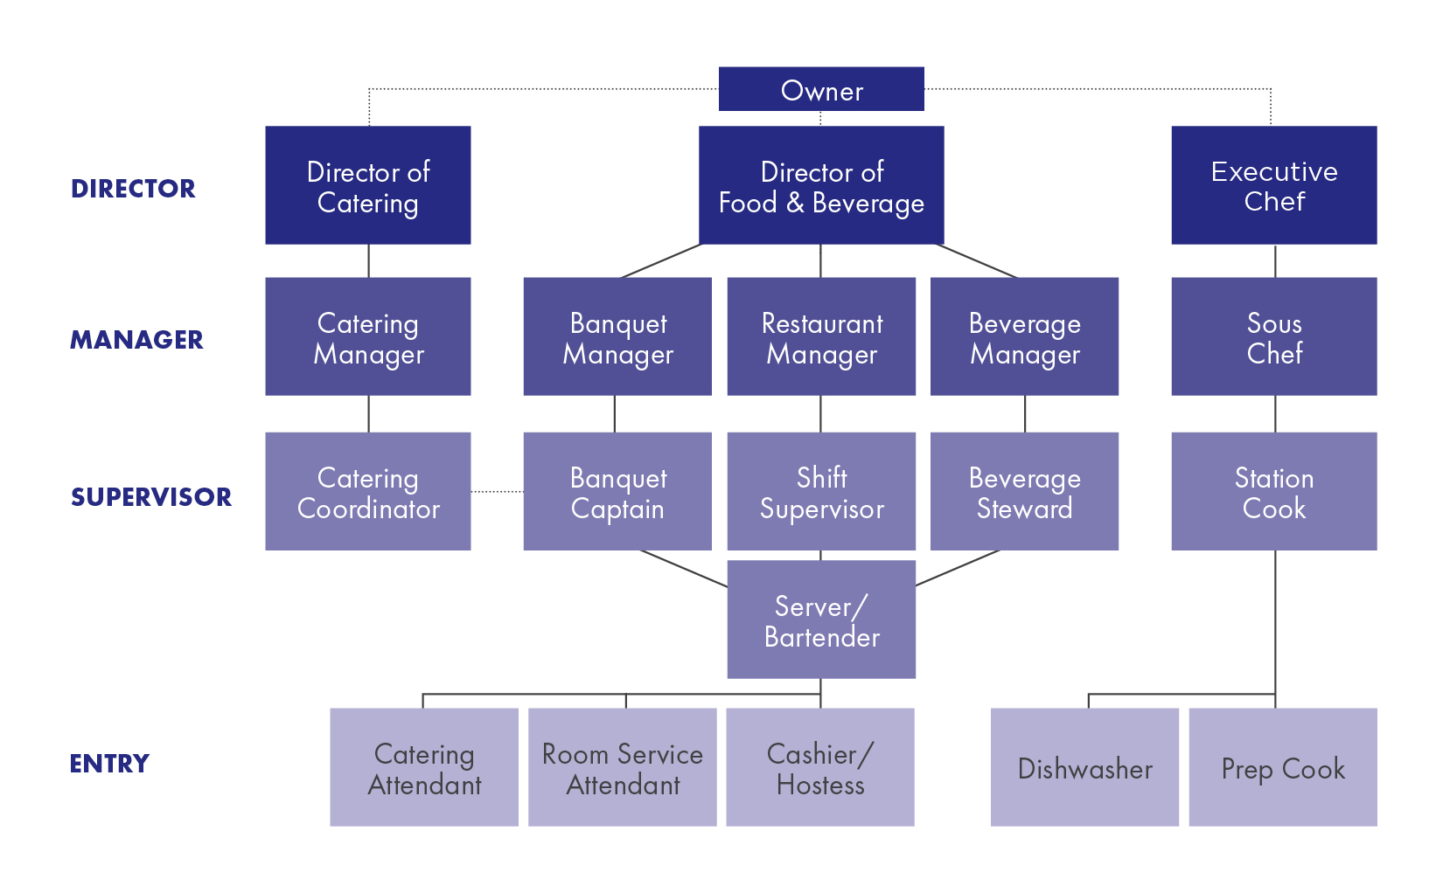
Career prospective or further education
Food and Beverage Stream Kitchen Operations and Cookery Stream

Slide 31
Requirements
2 year course
Qualifications:
SIT20316 - Certificate II in Hospitality
SIT20416 - Certificate II in Kitchen Operations
Work Placement:
Work placement is a mandatory HSC requirement within this Framework and 70 hours have been assigned to 240 hour Hospitality VET courses.
HSC requirements:
2 hour HSC written paper

Slide 32
Industrial Technology Board Developed Course 2 units – Preliminary and HSC ATAR
Focus areas studied at Gorokan High School
Automotive Technologies
Metal and Engineering Technologies
Timber and Furniture Products
Course Description
Industrial Technology at Stage 6 will develop a student's knowledge and understanding of a selected industry and its related technologies, highlighting the importance of design, management and production through practical experiences.
Industrial Technology Stage 6 consists of project work and an industry study that will develop a broad range of skills and knowledge related to the focus area chosen for the course.

Slide 33
What you will learn:
Course requirements:
In the Preliminary course, students must design, develop and construct a number of projects. Each project will include a management folio. Each project may emphasise different areas of the Preliminary course content. Students also undertake the study of an individual business within a focus area.
In the HSC course, students design, develop and construct a Major Design Project with a management folio. They will also undertake a study of the overall industry related to the specific focus area (Automotive, Metal or Timber).
Preliminary course | HSC course
Industry Study (15%) Design (10%) Management and Communication (20%) Production (40%) Industry Related Manufacturing Technology (15%) | Industry Study (15%) Major Project (60%) Design, Management and Communication Production Industry Related Manufacturing Technology (25%)

Slide 34
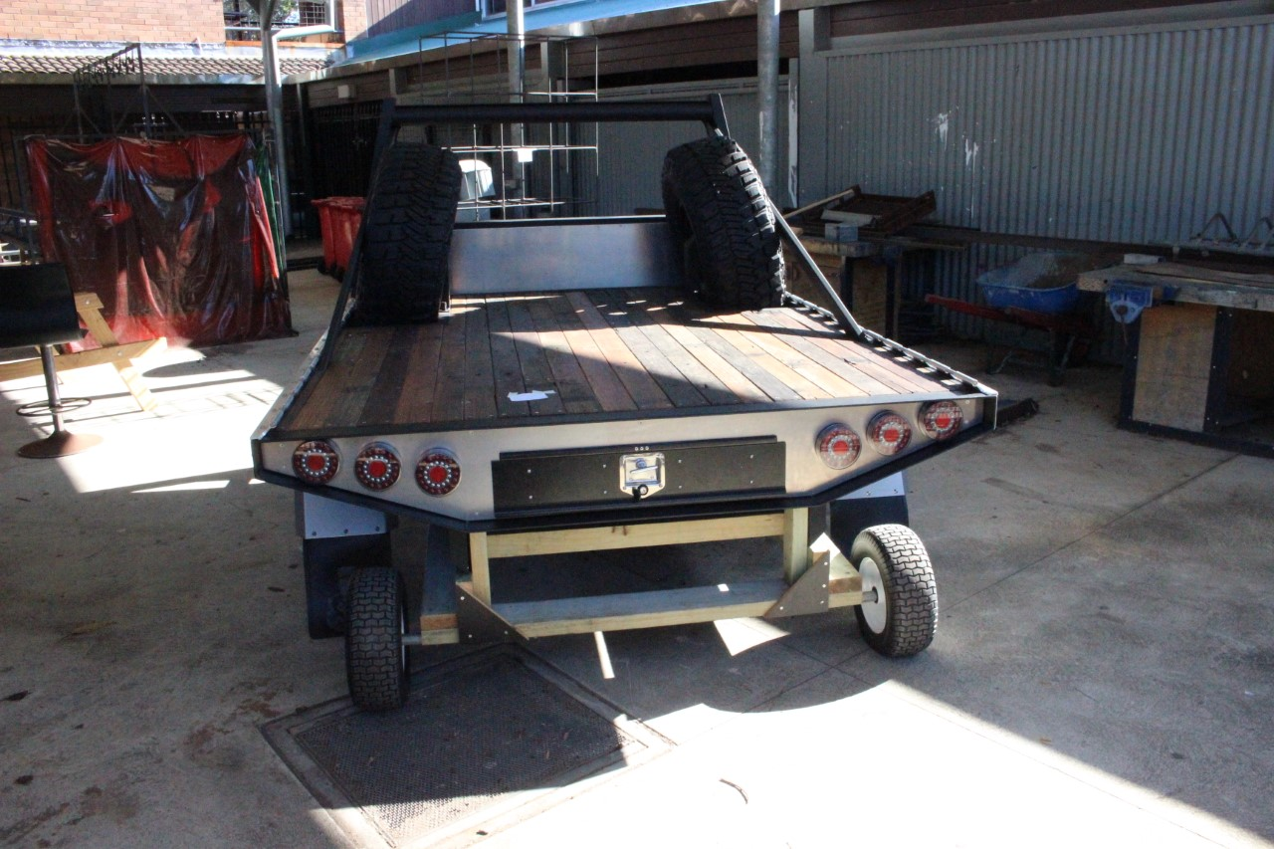
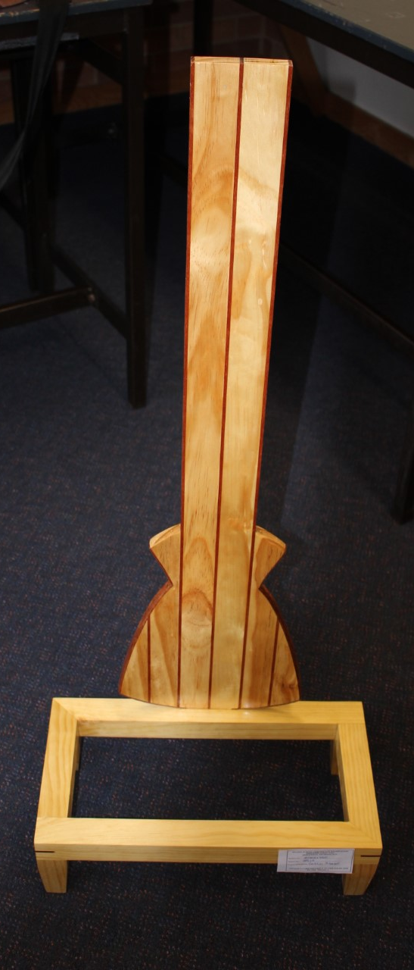
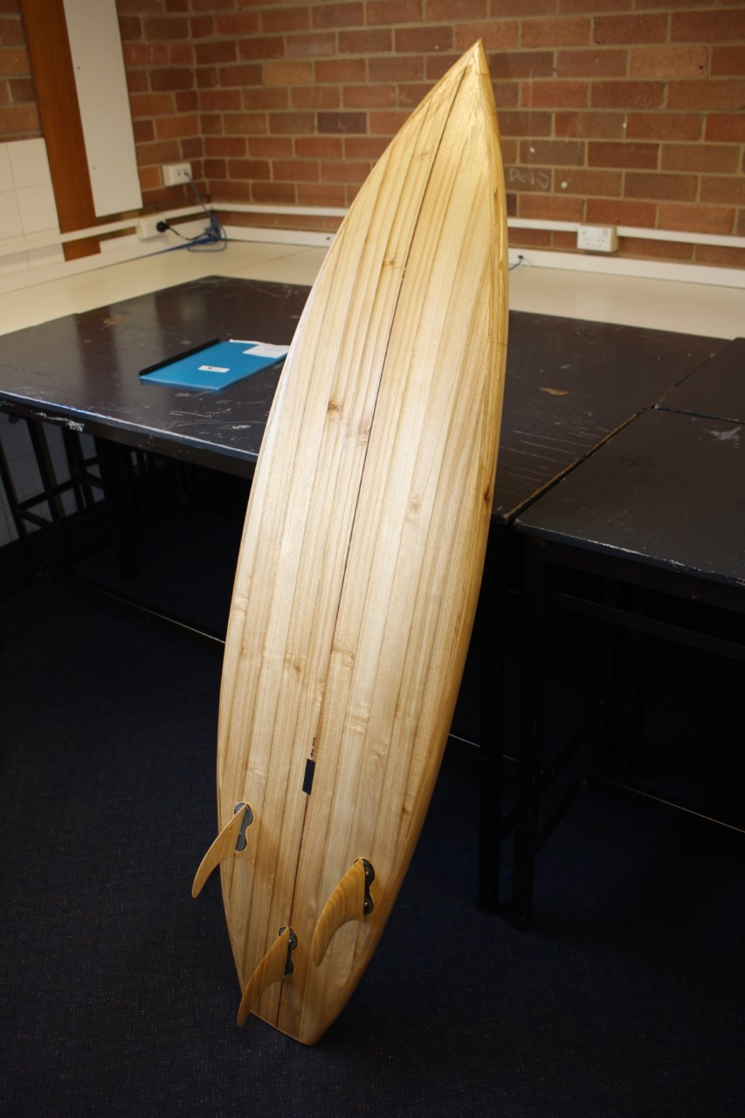
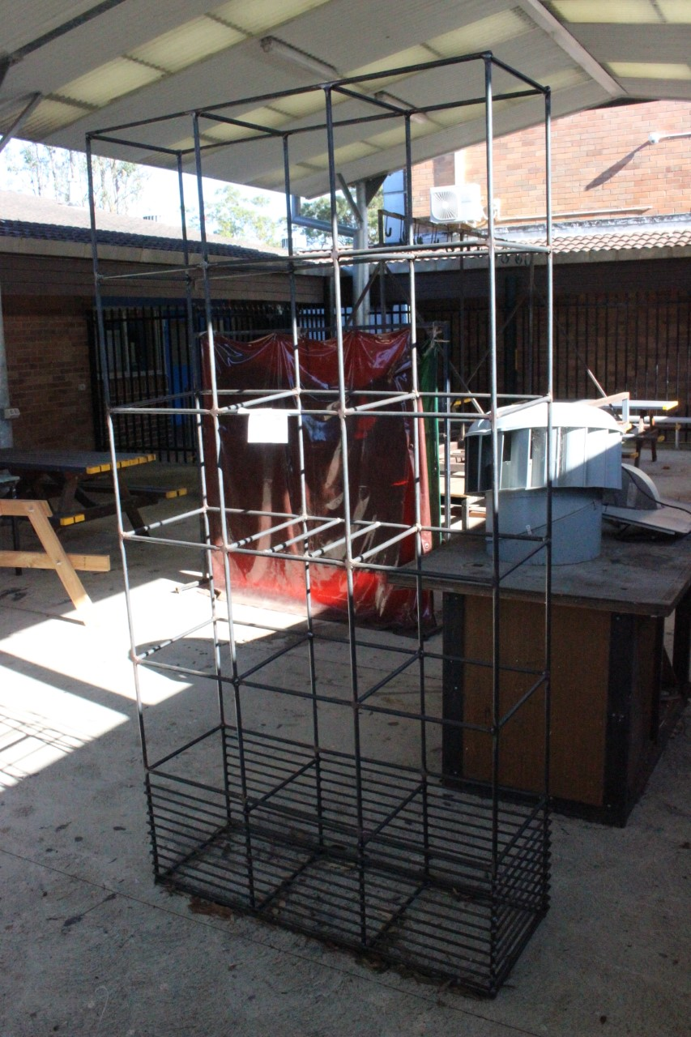
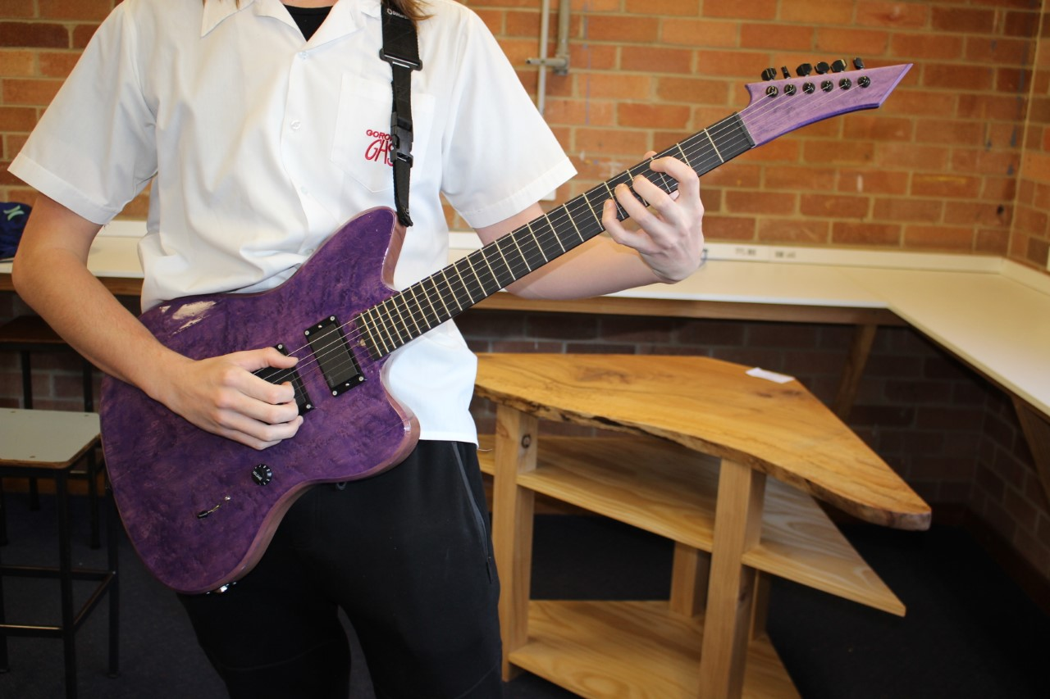
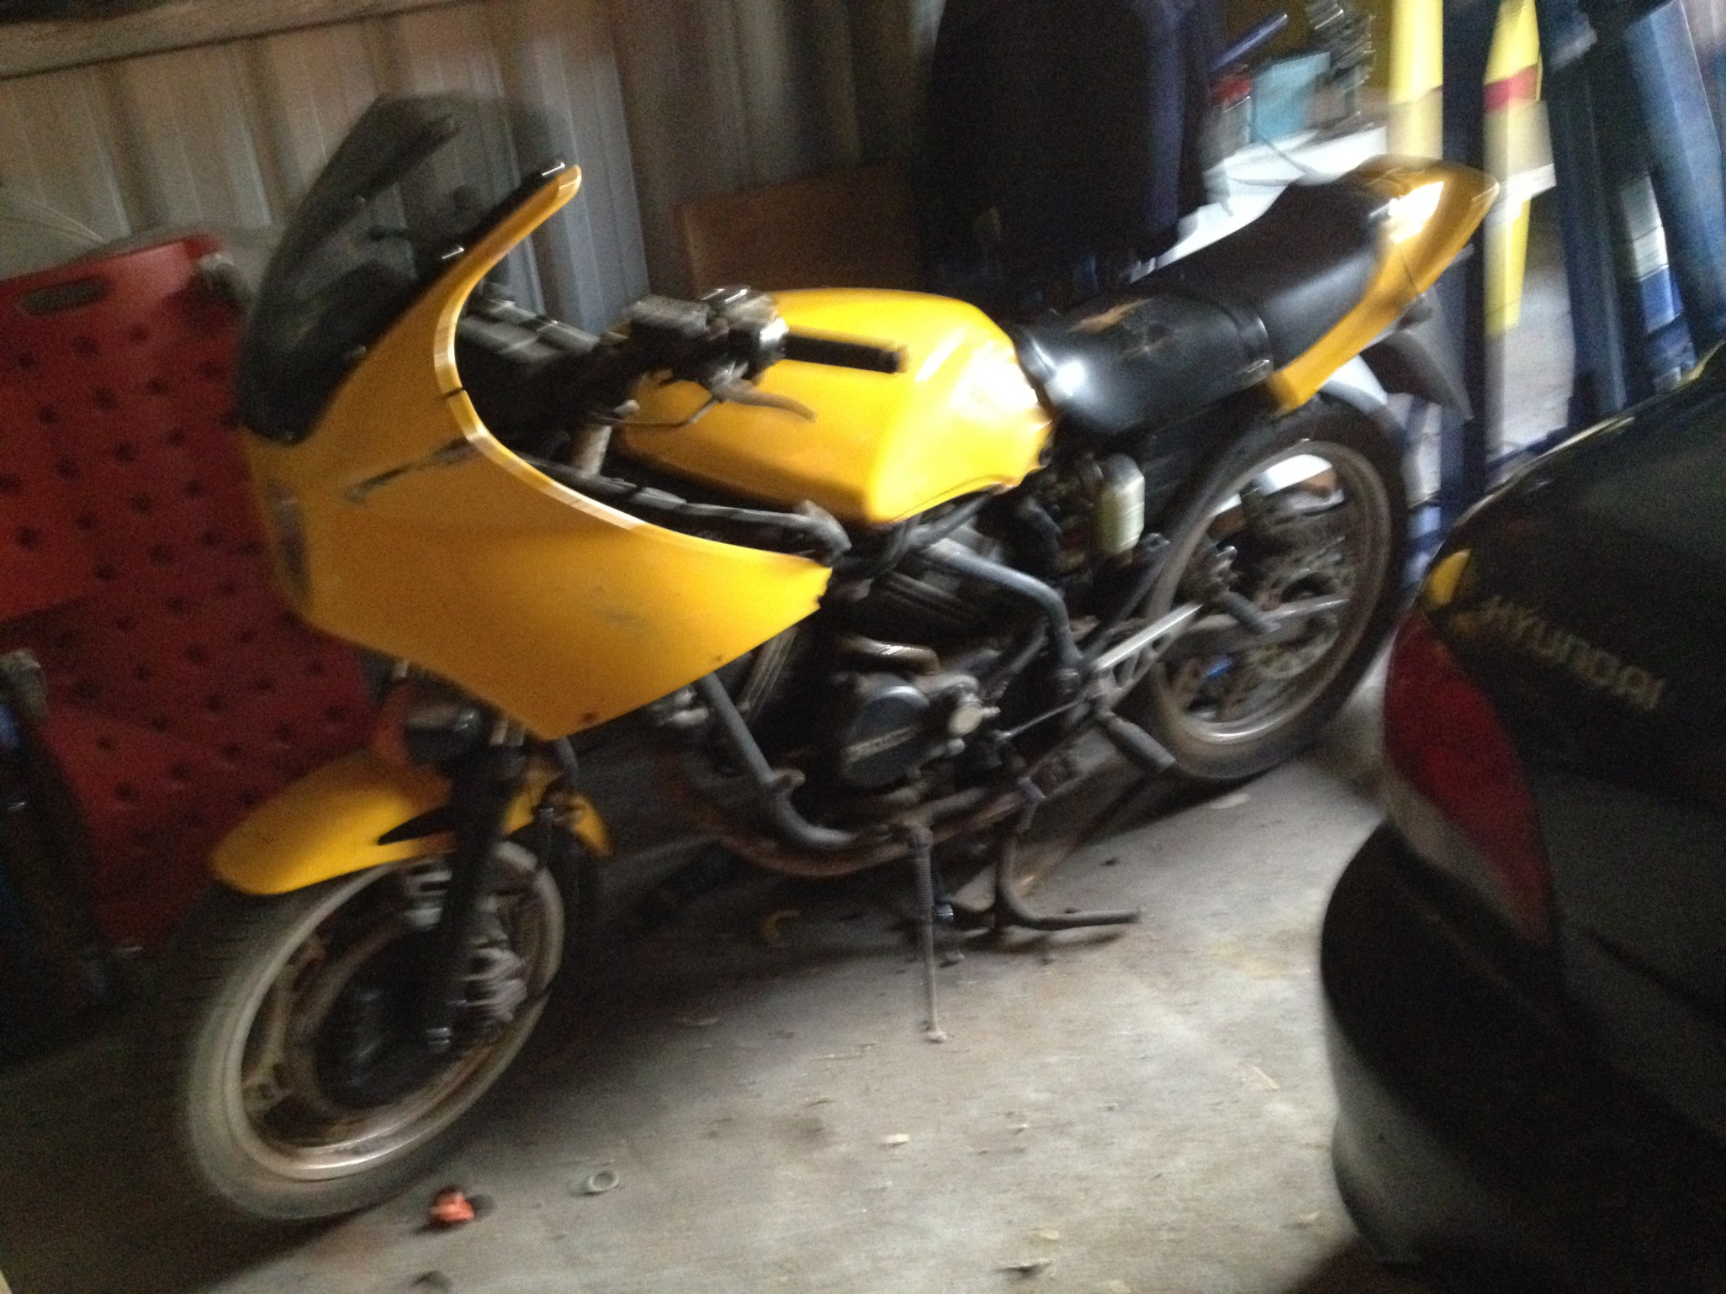
Automotive Metal Timber

Slide 35
HSC Requirements:
HSC written paper exam – 1 ½ hours + 5 minutes reading time = 40 marks
Major Design Project = 60 Marks:
Practical project – individual project (40 Marks)
Folio – This contains all the planning, development and manage of the Major Design Project.(20 Marks)
Component | Weighting
Knowledge and understanding of course content | 40%
Knowledge and skills in the design, management, communication and production of a major project | 60%

Slide 38
Because of Information and Communication Technologies
The job you will apply for in 2030!
Hasn’t been invented yet!

Slide 39
Learn practical ICT skills :
Information Technology
Learn skills to be part of the change :
Software Design & Development
Learn skills to understand the change :
Information Process and Technology

Slide 40
Software Design & Development
Category A
ATAR
Change the world ?
Board developed Course
2 units – Preliminary and HSCR
Course description
The Preliminary course introduces students to the basic concepts of computer software design and development. It does this by looking at the different ways in which software can be developed, the tools that can be used to assist in this process and by considering the interaction between software and the other components of the computer system.
The HSC course builds on the Preliminary course and involves the development and documentation of software using a variety of data structures and language facilities. Students learn to solve a number of interesting and relevant software problems.

Slide 41
What will I learn ?
Preliminary course:
Concepts and Issues in the Design and Development of Software (30%)
Introduction to Software Development (50%)
Developing Software Solutions (20%)
HSC course:
Development and Impact of Software Solutions (15%)
Software Development Cycle (40%)
Developing a Solution Package (25%)
Options (20%) – Study ONE of the following options:
Programming paradigms or
The interrelationship between software and hardware
Component | Weighting
Knowledge and understanding of course content | 50%
Knowledge and skills in the design and development of software solutions | 50%
HSC requirements: 3 hour written paper = 100 marks

Slide 43
What is the workload ?
Information Processes & Technology
Board Developed Course
2 units – Preliminary and HSC
Course Description:
Information Processes and Technology is the study of information-based systems. It focuses on information processes performed by these systems and the information technology that allows them to take place. Social, ethical and non-computer procedures resulting from the processes are considered. Different types of information systems are studied. Through project work, students will create their own information system to meet an identified need.
understand the changes

Slide 44
What will you learn ?
Preliminary course
Introduction to Information Skills and Systems (20%)
Tools for Information Processes (50%)
Developing Information Systems (30%)
HSC course
Project Management (20%)
Information Systems and Databases (20%)
Communication Systems (20%)
Option Strands (40%) – Students will select TWO of the following options:
Transaction Processing Systems
Decision Support Systems
Automated Manufacturing Systems
Multimedia Systems.

Slide 45
Course requirements:
Component | Weighting
Knowledge and understanding of course content | 60%
Knowledge and skills in the design and development of information systems | 40%
HSC written paper: 3 hours + 5 minutes reading time

Slide 46
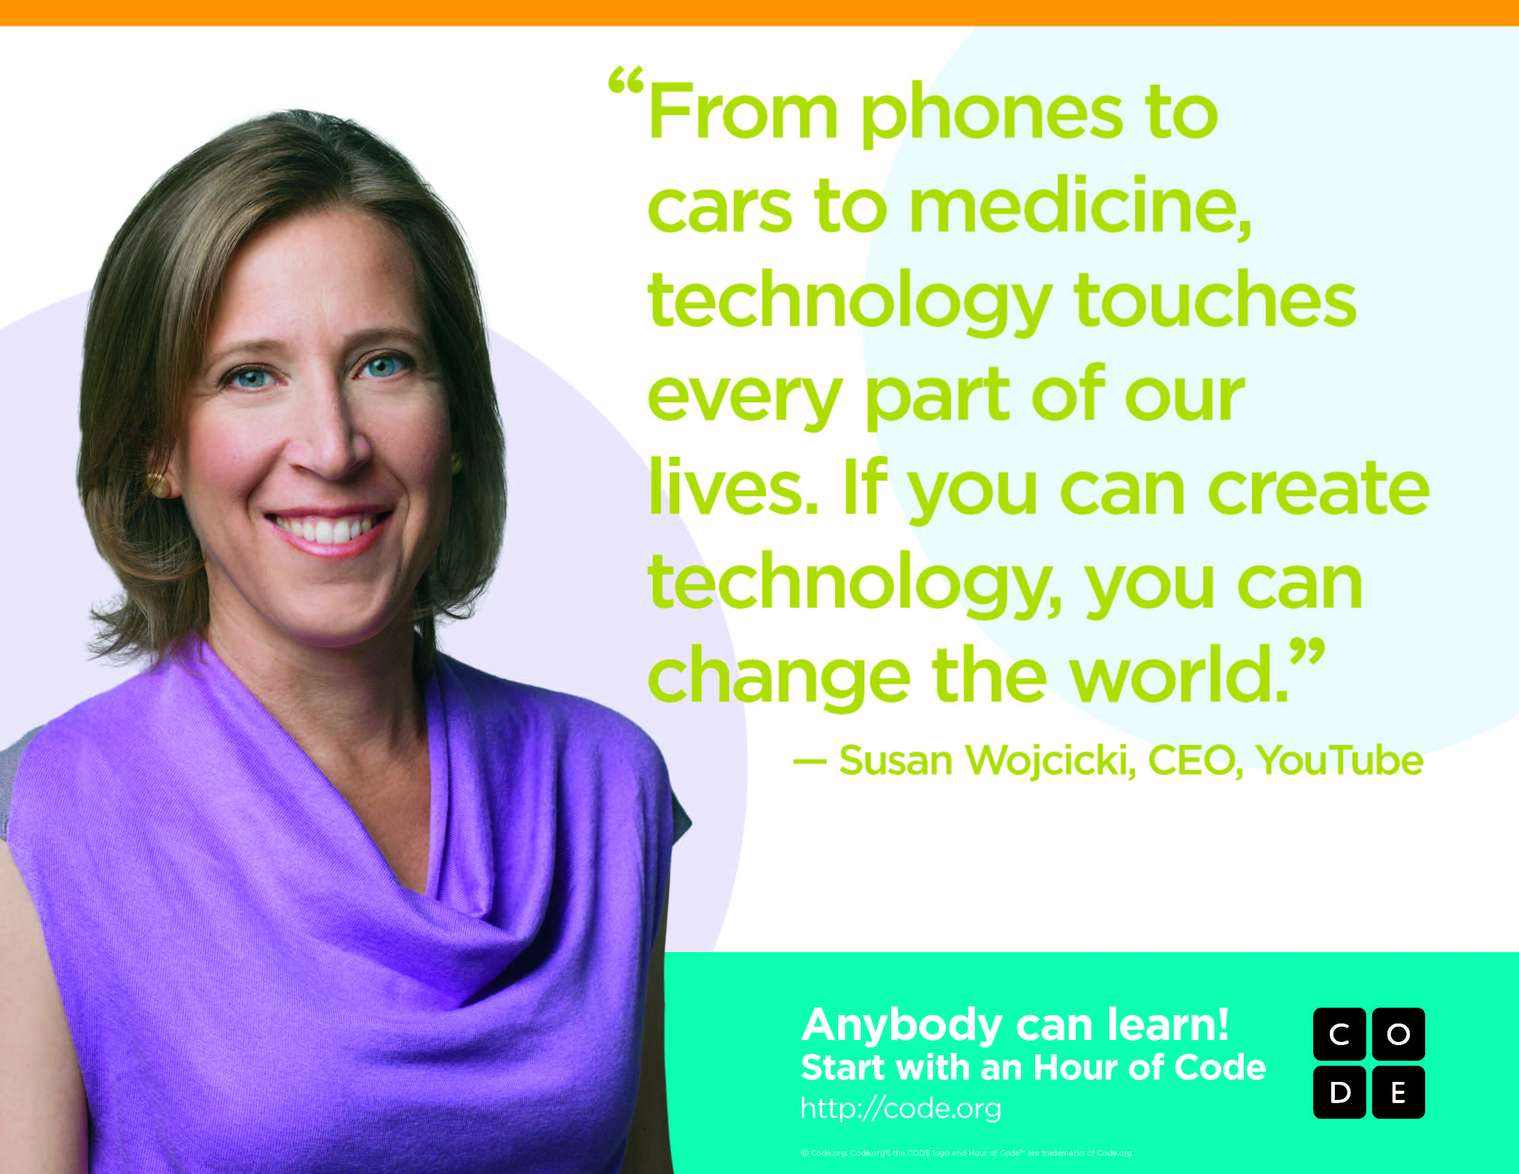

Slide 47
Practical knowledge?
Information and Digital Technology Curriculum Framework
Board Developed Course
2 units – Preliminary and HSC
VET
Course description
The Preliminary course introduces students to the basic concepts of computer software design and development. It does this by looking at the different ways in which software can be developed, the tools that can be used to assist in this process and by considering the interaction between software and the other components of the computer system.
The HSC course builds on the Preliminary course and involves the development and documentation of software using a variety of data structures and language facilities. Students learn to solve a number of interesting and relevant software problems.

Slide 48
Which qualification?
Statement of Attainment towards Cert III in Information, Digital Media and Technology ICT20120
Record on HSC transcript

Slide 49
What will I learn?
Preliminary course
Concepts and Issues in the Design and Development of Software (30%)
Introduction to Software Development (50%)
Developing Software Solutions (20%)
HSC course
Development and Impact of Software Solutions (15%)
Software Development Cycle (40%)
Developing a Solution Package (25%)
Options (20%) – Study ONE of the following options:
Programming paradigms or
The interrelationship between software and hardware
HSC written paper: 2 hours plus 5 minutes reading time = 80 marks

Slide 50
What’s the workload?
It is a mandatory requirement that students spend a minimum of 20% of Preliminary course time and 25% of HSC course time on practical activities using the computer.
You will complete at least 12 assessment events including exams.
Workplacement is mandatory: 70 hours

Slide 52
SOCIETY AND CULTURE

Slide 53
Board Developed Course 2 unit Preliminary and HSC Category A ATAR
Course description:
Society and Culture develops social and cultural literacy and a clear understanding of the interactions of persons, society, culture, environment and time, and how these shape human behaviour. The course draws on cross-disciplinary concepts and social research methods, and students undertake research in an area of particular interest to them. The research findings are presented for external assessment in the Personal Interest Project (PIP).

Slide 54
What will I learn:
Preliminary course | HSC course
The Social and Cultural World: The interactions between persons and groups within societies Personal and Social Identity: Socialisation and the development of personal and social identity in a variety of social and cultural settings Intercultural Communication: How people in different social, cultural and environmental settings behave, communicate and perceive the world around them | Core Social and Cultural Continuity and Change: The nature of social and cultural continuity and change as well as application of research methods and social theory to a selected country study The Personal Interest Project (PIP): An individual research project Depth Studies Popular Culture: The interconnection between popular culture, society and the individual Social Inclusion and Exclusion: The nature of social inclusion and exclusion as well as implications for individuals and groups in societies and cultures

Slide 55
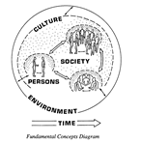
Aim
The aim of Society and Culture Stage 6 is to develop a student’s knowledge, understanding, skills, values and attitudes essential to achieving social and cultural literacy by examining the interactions between persons, societies, cultures and environments across time.

Slide 56
Society and Culture has direct relevance to the immediate needs of students and to their future lives by enabling students to develop understanding of:
• themselves
• their own society and culture
• the societies and cultures of others.

Slide 57
COURSE STRUCTURE
Preliminary Course
•The Social and Cultural World (30% of course time)
•Personal and Social Identity (40% of course time)
•Intercultural Communication (30% of course time)
HSC Course
Core
Personal Interest Project (30% of course)
Social and Cultural Continuity and Change (30% of course)
Depth studies (40% of course)
Popular Culture
Social Inclusion and Exclusion

Slide 58
HSC Requirements:
HSC written paper: 2 hours
+ 5 minutes reading time = 60 marks
Personal Interest Project: = 40 marks
Component | Weighting
Knowledge and understanding of course content | 50%
Application and evaluation of social and cultural research methods | 30%
Communication of information, ideas and issues in appropriate forms | 20%

Slide 59
Textiles and Design
Board Developed Course
2 units – Preliminary and HSC
Category A
ATAR
Course Description:
The Preliminary course involves the study of design, communication techniques, manufacturing methods, fibres, yarns, fabrics and the Australian Textile, Clothing, Footwear and Allied Industries. Practical experiences, experimenting and product manufacturing are integrated throughout the content areas and include the completion of two preliminary textile projects. These projects develop each student's creative abilities and skills in designing, manipulating, experimenting and selecting appropriate fabrics for an end use.
The HSC course builds upon the Preliminary course and involves the study of fabric colouration and decoration, historical design development, cultural factors that influence design and designers, contemporary designers, end-use applications of textiles, innovations and emerging textile technologies, appropriate textile technology and environmental sustainability, current issues and the marketplace.
This course involves the development of a Major Textiles Project, worth 50% of the HSC mark. The project is selected from one of the five focus areas and enables students to explore an area of interest. The project has two components: the supporting documentation and textile item(s).

Slide 60
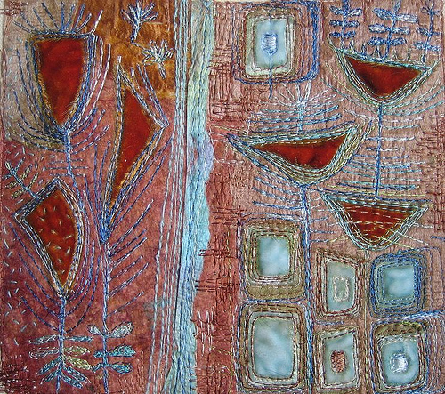
AIM
Textiles and Design Stage 6 is designed
to enable students to understand and
appreciate the nature and significance
of textiles and to develop confidence
and competence in the selection, design,
manufacture and application of textile items.

Slide 61
What you will learn:
Preliminary course | HSC course
Design (40%) Properties and Performance of Textiles (50%) The Australian Textile, Clothing, Footwear and Allied Industries (10%) | Design (20%) Properties and Performance of Textiles (20%) The Australian Textile, Clothing, Footwear and Allied Industries (10%) Major Textiles Project (50%)
Course requirements
In the Preliminary course students will undertake two preliminary textile projects. Preliminary Project 1 is drawn from the area of study of Design and focuses on the generation and communication of ideas, design modification, manipulative skills, evaluation of ideas and of the project, and management of time and resources. Preliminary Project 2 is drawn from the area of study of Properties and Performance of Textiles and focuses on an analysis of fabric, yarn and fibre properties, experimental procedures, product design, fabric choice, manipulative and management skills, communication methods and the recording of information.
In the HSC course, the Major Textiles Project allows students to develop a textile project from one of the following focus areas: apparel, furnishings, costume, textile arts, non-apparel. The selected focus area allows students to explore in detail one area of interest through a creative textile design process that integrates the areas of Design, Properties and Performance of Textiles and the Australian Textile, Clothing, Footwear and Allied Industries.

Slide 62
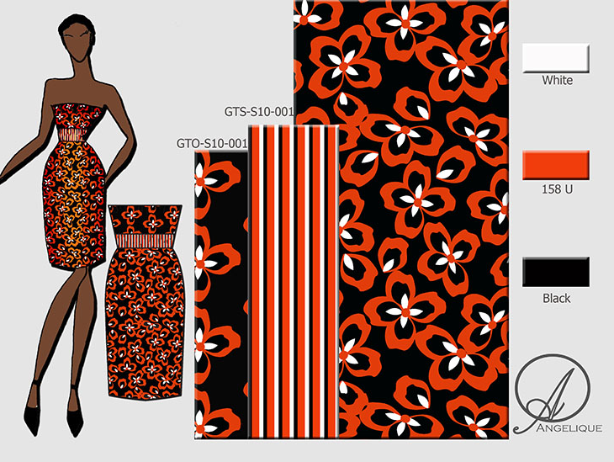
Areas of Study
Design
Students will look at the:
Types
Elements
Principles
Communication
Manufacturing

Slide 63
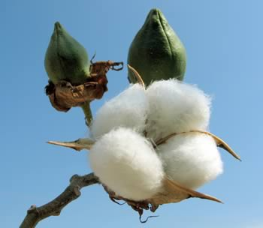
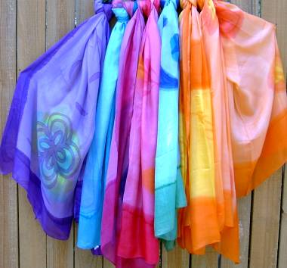
2. Properties and Performance of Textiles
Students will learn about:
Fibres like silk
Fibre:
classification
Fibre Properties
Fibre Structure
Types of yarns
Fabric Structure
Fabric Testing

Slide 64
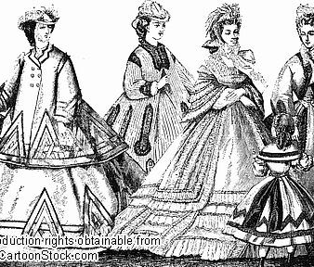
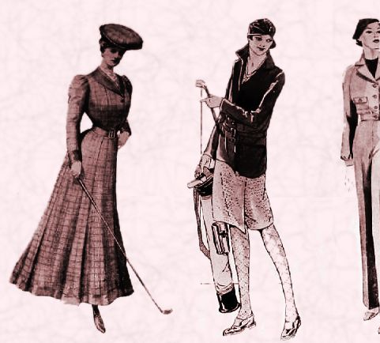
3. Australian Textile, Clothing, Footwear and Allied Industries
19th Century
20th Century
21st Century

Slide 65
Projects
Select one from the list below for your MTP:
Apparel
Non-apparel
Costume
Furnishings
Textile Art

Slide 66
HSC exam requirements:
Component | Weighting
Knowledge and understanding of course content | 50%
Skills and knowledge in the design, manufacture and management of a major textiles project | 50%
HSC written paper exam:
1½ hours + 5 minutes reading time = 50 marks
Major Textile Project = 50 marks
Project = 25 marks
Supporting folio = 25 marks

Slide 67
Questions?
Contact any teacher in the TAS staffroom
Links and attachments will be on school website for:
this presentation
a link to our website where there is more information about each course
TAS handout from expo night

